Slide 1
Chapter 5: Assembly Language and the PEP/8 Virtual Computer
Notes:
As you can see from the last chapter, it is very tedious to code in machine language. So Assembly language was developed that allowed the programmer to use mneumonic codes for the instructions that were easier for humans to read and understand. In this chapter, we will learn to write programs in Assembly language.

Slide 2
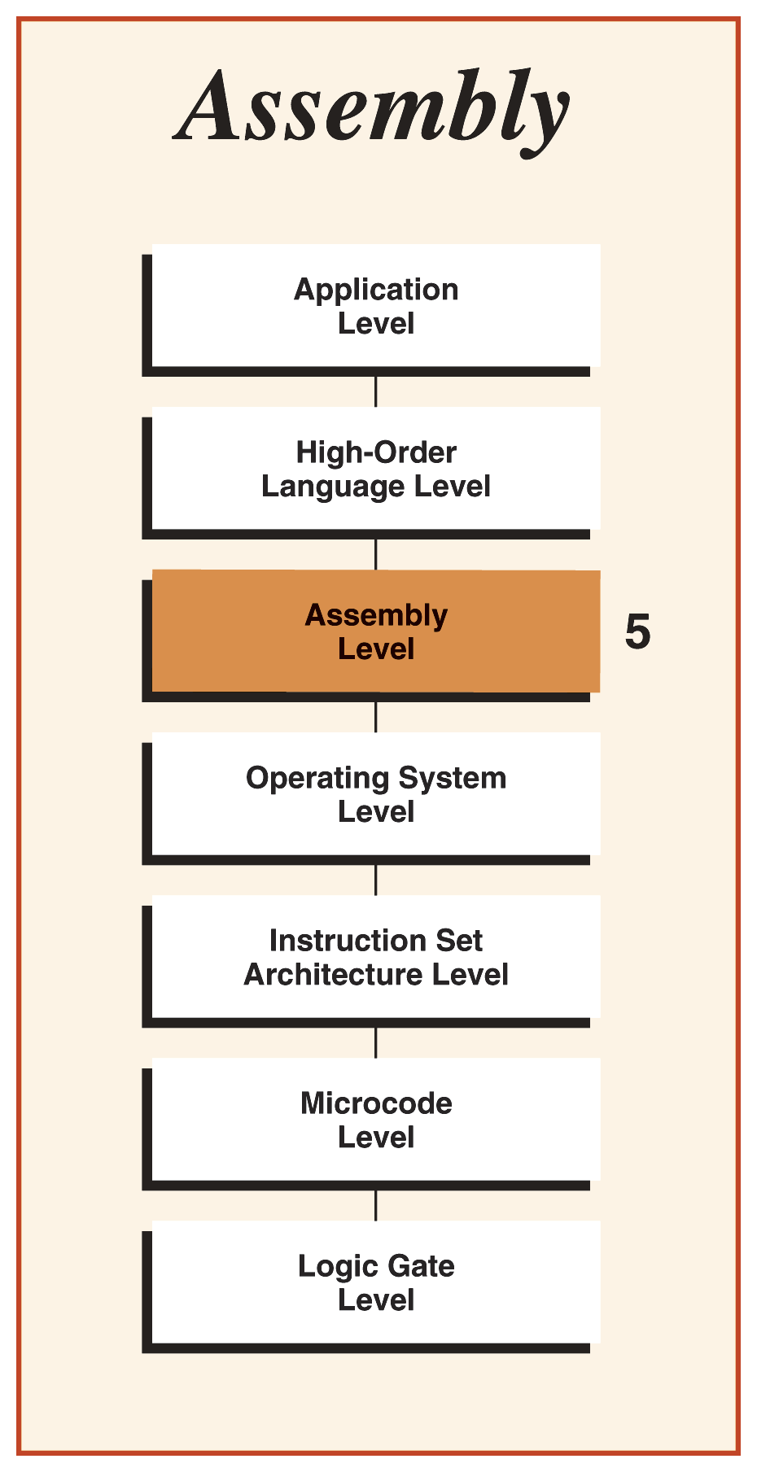
Chapter 5 Objectives
Learning Objectives:
Describe the basic assembly language format
Translate simple instructions between assembly and machine languages
Define the function of directives
Use directives to define data memory
Use directives to instruct the assembler
Describe the role of an assembler
Notes:
Our Learning Objectives are:
Describe the basic assembly language format
Translate simple instructions between assembly and machine languages
Define the function of directives
Use directives to define data memory
Use directives to instruct the assembler
Describe the role of an assembler

Slide 3
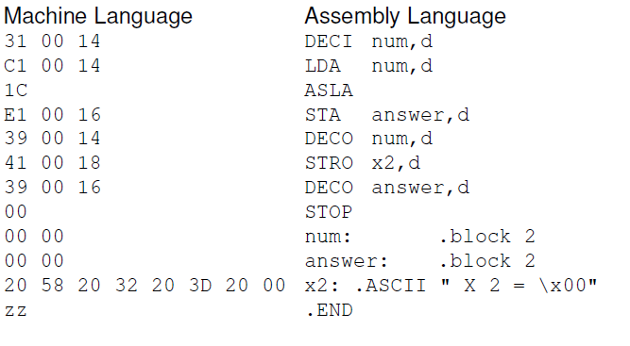
Comparison of Languages
Chapter 4 - ISA level (Level 3 )
Programs in Machine Language
Chapter 5 - Assembly Language (level 5)
Notes:
In Chapter 4 we worked at the ISA level (Level 3 ) and wrote our programs in Machine Language.
In this chapter we move up in our levels of abstraction to the Assembly Language (level 5)
Here we see a machine language program with the equivalent assembly language program next to it.
As you can see the Assembly Language is more human friendly, though still fairly cryptic.

Slide 4
Assembly Language
ISA Level 3: 2 types of bit patterns
Instructions
Data
Assembly Language:2 types of corresponding statements
Instructions
Mnemonics for opcodes
Letters for addressing modes
Data
Pseudo-ops, also called dot commands
Notes:
At ISA Level 3: We had 2 types of bit patterns
Instructions
Data
Assembly Language contains two types of statements corresponding to these:
The Instructions consist of
Mnemonics for opcodes
Letters for addressing modes
And the Data locations are indicated with
Pseudo-ops, also called dot commands

Slide 5
Assembly Language
Assembly Language Instruction Format
One instruction per line
Mnemonics replace bit codes:
Opcode
Register
Addressing mode
Extra spaces allowed
Comments may follow code
Notes:
Assembly Language Instruction Format consists of One instruction per line
However, Mnemonics replace bit codes:
The Opcode, Register, & Addressing mode are all specified using the letters shown in the front cover of your book.
Extra spaces are allowed and Comments may follow the code
Comments are very important for assembly code that is why I tried to get you in the habit on your C++ programs.

Slide 6
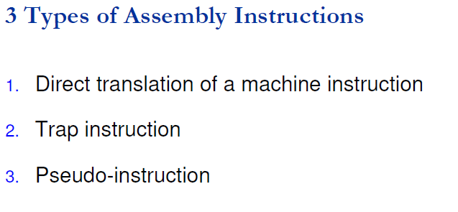
Assembly Language
Notes:
In Assembly language there are three types of Instructions:
The direct translation of a machine instruction, a trap instruction and a pseudo instruction.
Let’s look at each of these in detail.

Slide 7
Direct Translation: Instructions Mnemonics
The instruction, register specifier, and addressing mode are all present:
LDX 0x009A, i
address type (hex)
addressing mode
opcode
Operand specifier
register
specifier
Notes:
A direct translation instruction consists of Instruction mnemonics.
The instruction, register specifier, and addressing mode are all present
<click>
Here we see the opcode or Load
<click>
The register specifier X for the index register
<click>
The Operand specifier 009A, which looks the same as the machine code specifier
<click>
The 0x indicates that the address type is hex
<click>
And the addressing mode I for immediate.

Slide 8
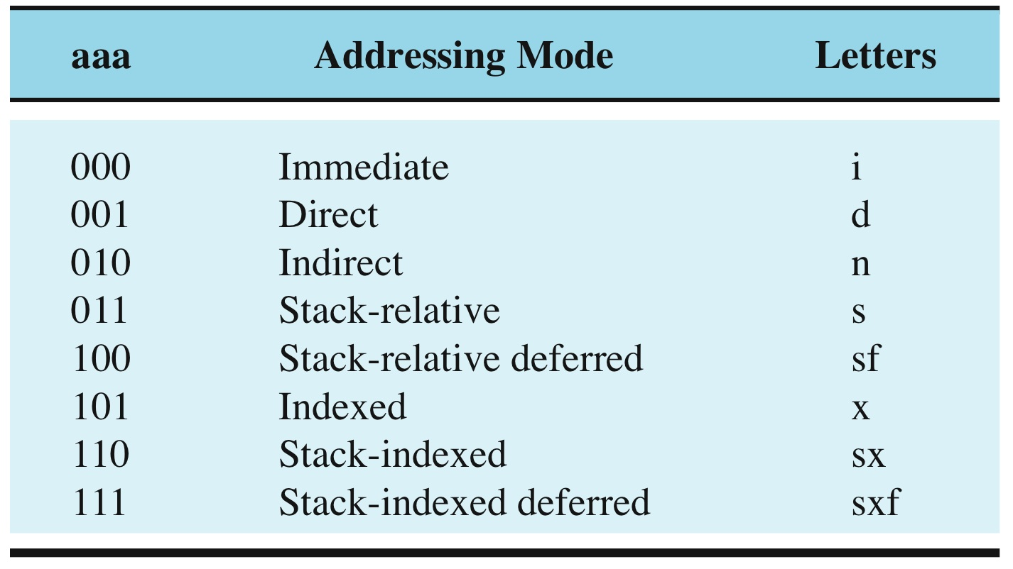
Addressing Modes
LDX 0x009A, i
addressing mode
Specify addressing mode by placing a comma followed by a letter at the end of the instruction
Notes:
Here are the addressing modes for the PEP/8. They are specified by placing a comma followed by a letter at the end of the instruction.
In this chapter we will continue using direct and we will add immediate, which means that the data is immediately following the instruction.
The others will be defined in Chapter 6 when we begin using the stack and indexing arrays.

Slide 9
Direct Translation: Instructions Mnemonics
(Example 5.1 program comparison)
LDX and LDA in assembler correspond to the same machine language statement (1100 raaa).
The difference is in
the r (register bit).
A refers to the accumulator
X refers to the index register
And the Addressing mode bits aaa
1100 0011 0000 0000 1001 1010 LDA 0x009A,s
1100 0110 0000 0000 1001 1010 LDA 0x009A,sx
1100 1011 0000 0000 1001 1010 LDX 0x009A,s
1100 1110 0000 0000 1001 1010 LDX 0x009A,sx
Notes:
Here we see different variations of the load instruction.
The red 0s & 1s in the machine code relate to the red As & Xs in the Assembly code. Both indicate the register.
The blue 0s & 1s in the machine code relate to the blue s & sx in the Assembly code. Both indicate the addressing mode.

Slide 10
1. Direct Translation of a Machine Instruction
Notes:
Here are the different sections of the Machine code and Assembly code side by side.
However the addressing mode is at the end of the Assembly code and it is bit 6,7, & 8 in the machine code

Slide 11
2. Trap Instructions
Exist at level 5 but not level 3
unimplemented opcode instructions from fig.4.6, pg 155
Notes:
Now we will move on to trap instructions:
These exist at level 5 but not at level 3.
These were unimplemented opcode instructions from Chapter 4.
However, we will program as if they exist at level 3 even though they are not.
The OS or operating system at level 4 provides an interrupt service routine to handle these. Chapter 8 will explain how these are handled.
Trap Instructions look like direct machine instructions, but in reality they transfer control to the operating system. They invoke functions that only the Operating System has the permission or capability to perform.

Slide 12
3. Pseudo-Operations
Assembly language statements
Do not have opcodes and do not correspond to any instruction in Pep/8
All pseudo-ops (except .BURN, .END, and .EQUATE) insert data bits into the machine language program
Called assembly directives or dot commands
Notes:
Let’s move on to Pseudo Operations.
These are Assembly language statements however they do not have opcodes and do not correspond to any instruction in Pep/8.
All pseudo-ops except for .BURN, .END, and .EQUATE insert data bits into the machine language program.
They are called assembly directives or dot commands because each must be preceded by a . in assembly language

Slide 13
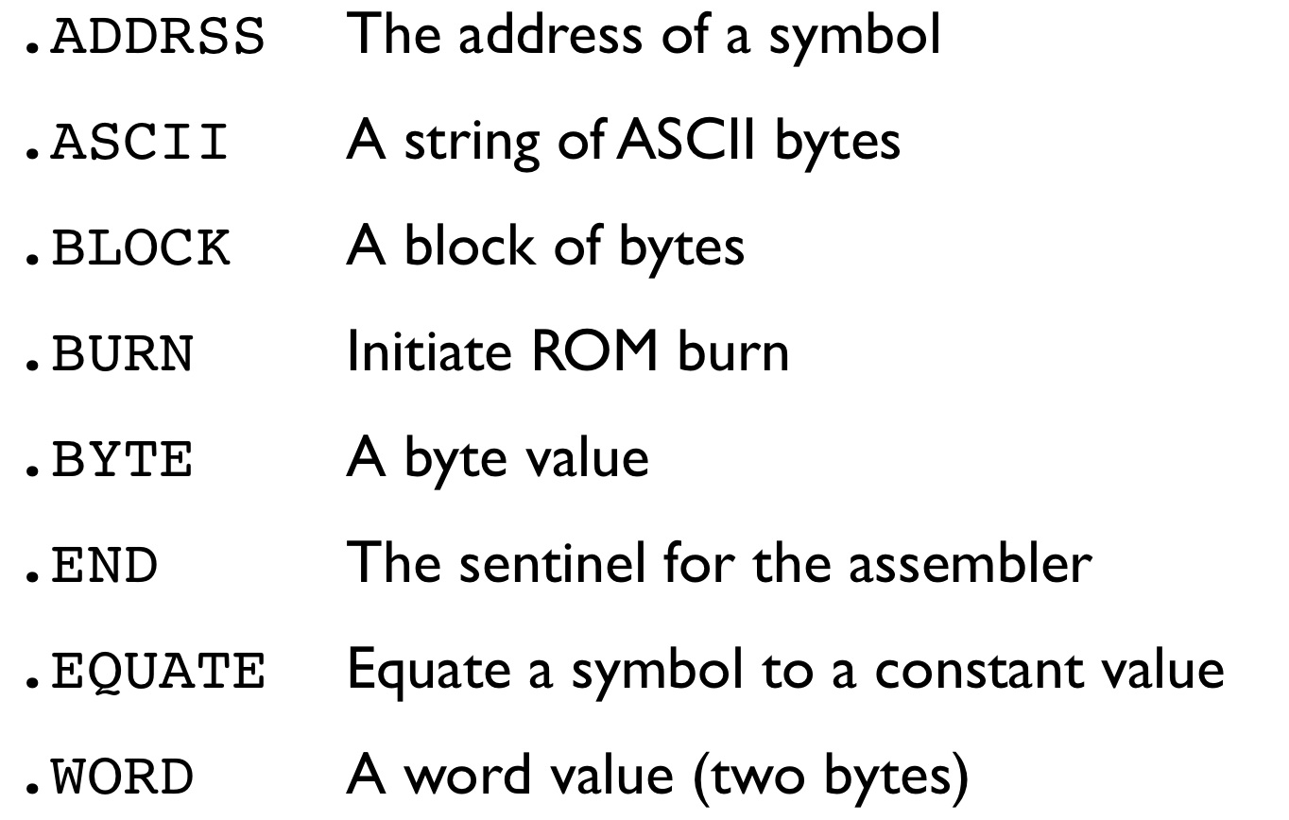
Pseudo-Operations
Notes:
Here are the eight pseudo-ops in PEP/8 assembly language.
We will review some examples on how to use these.

Slide 14
Pseudo-operations/Assembly directives
Must place at least one space after the mnemonic or dot command
No other restrictions on spacing
No restrictions on capitalization.
Can use any combination of upper/lower case
Notes:
The syntax pseudo-ops is simple.
There must be one space after the mneumonic or dot command and extra spaces are fine. The spaces can be followed by a value and/or a comment.
Also, it can be uppercase or lowercase or a mix. It does not care.

Slide 15
PEP/8 Example
Program in Figure 5.3
is program in Fig 4.32 written in assembly language
Pep/8 is line oriented.
One assembly language statement per line
Comments begin with semicolon and continue to end of line
Notes:
This Program form Figure 5.3 is the machine language program from Chapter 4 - Fig 4.32 written in assembly language.
Pep/8 is line oriented.
One assembly language statement per line
Comments begin with semicolon and continue to end of line
Here we see the Assembler Output as we wrote it in Chapter 4 and the same Program Output.

Slide 16
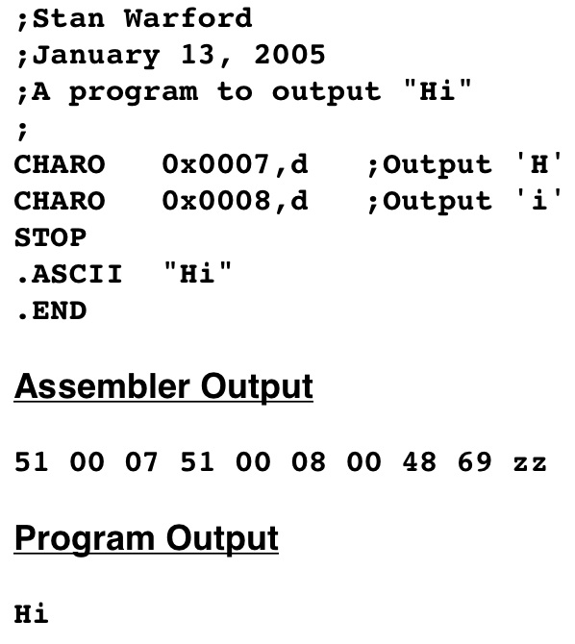
An assembly language program to output Hi
Mnemonic for char output instruction
Assembler directive. Puts ascii code in
Halts assembler. Need both Stop
And .END
Notes:
Let’s look at this program closer.
<click>
First there are two character output instructions or CHARO the mnemonic for character output.
<click>
This is an assembler directive that puts in the ascii code.
<click>
Finally there is an END statement. This tells the assembler it has reached the end of the code.
The STOP statement marks the end of the program execution. Both are needed.

Slide 17
.ASCII Pseudo-op
Generates contiguous bytes of ASCII characters
Must enclose in double quotes
To include a double quote in the string, precede it with a backslash \”
To include a backslash, use two backslash characters \\
Newline is \n, tab is \t
To include arbitrary bytes in the string, use \x
Assembler expects the next two bytes to be hexadecimal digits
Notes:
The .ascii Pseudo-op generates contiguous bytes of ASCII characters
The ASCII characters following it must be enclosed in double quotes.
To include a double quote in the string, precede it with a backslash.
To include a backslash, use two backslash characters.
A Newline is \n, tab is \t
To include arbitrary bytes in the string, use \x
After this code the Assembler expects the next two bytes to be hexadecimal digits.

Slide 18
.ASCII Pseudo-op
Examples:
.ascii "Hello\nWorld."
.ascii Hello\x0AWorld\x2E"
Both produce the following sequence of bytes:
48 65 6C 6C 6F 0A 57 6F 72 6C 64 2E
Notes:
Here are two examples that both produce the same sequence of bytes as shown.

Slide 19
.END Pseudo-op
.END is just a sentinel to the assembler to know when to stop translating
.END actually produces zz
Notes:
The .END is just a sentinel to the assembler to know when to stop translating
The .END also produces the zz at the end of the machine code which tells the loader to stop reading.
The zz is not code that will be loaded.

Slide 20
Assemblers
Assembly code must be translated into machine language
Input: source program
Output: object program
Assembler does not load or execute a program
Assembler - program written in machine language
Assembler must be loaded before used
Notes:
Assembly code must be translated into machine language
Input: source program
Output: object program
Assembler does not load or execute a program
Assembler is a program that must be written in machine language
Assembler must be loaded before being used

Slide 21
Assemblers
Output from the Pep/8 assembler:
Hex machine language file
In Object Code window pane
A program listing
In Assembly Listing window pane
Converts source code to consistent format of upper/lower case
Adds memory location address for each line
Adds machine code for each line
.END Pseudo-op does not generate any code
Notes:
Output from the Pep/8 assembler:
Hex machine language file in the Object Code window pane
A program listing in the Assembly Listing window pane
This listing shows the source program converted to a consistent format of upper and lower case
It shows memory location address for each line and the machine code for each line
The .END Pseudo-op does not generate any code.

Slide 22
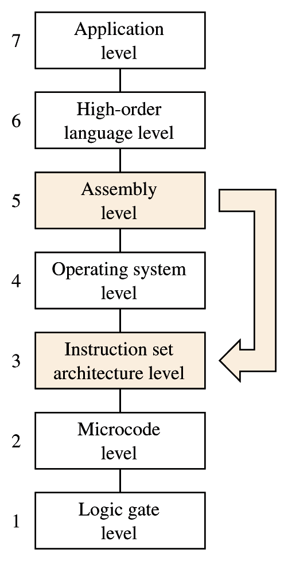
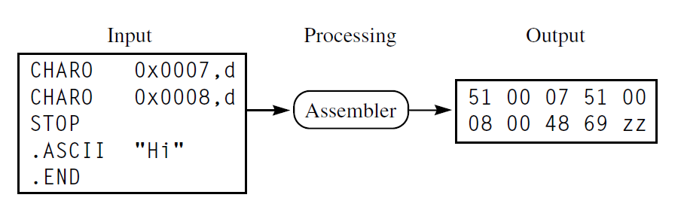
The function of an assembler
The PEP/8 assembler takes your assembly code and translates it into machine code
Most Asmb5 instructions -> ISA3 instructions
Some Asmb5 instructions -> OS4 traps
Some Asmb5 instructions -> ISA3 data or a Meta-instruction for the translator itself
Notes:
Here is our familiar, Input – Processing – Output model again.
In this case, the input is the source code, the Assembler does the processing and the output is the machine code and some OS traps.

Slide 23
Program Figure 5.6
Assembly version of program Fig 4.34
Inputs two char, prints them in reverse order
Notes:
Here is the assembly language version of the machine language program from Chapter 4 - Fig 4.34.
It uses CHARI to input two characters and store them at memory locations 000D & 000E
Then uses CHARO to output them in reverse order.
When the source code is entered into the PEP8 and Assemble is selected (the hammer) the Object code is output.
Then this program can be ran just like before.

Slide 24
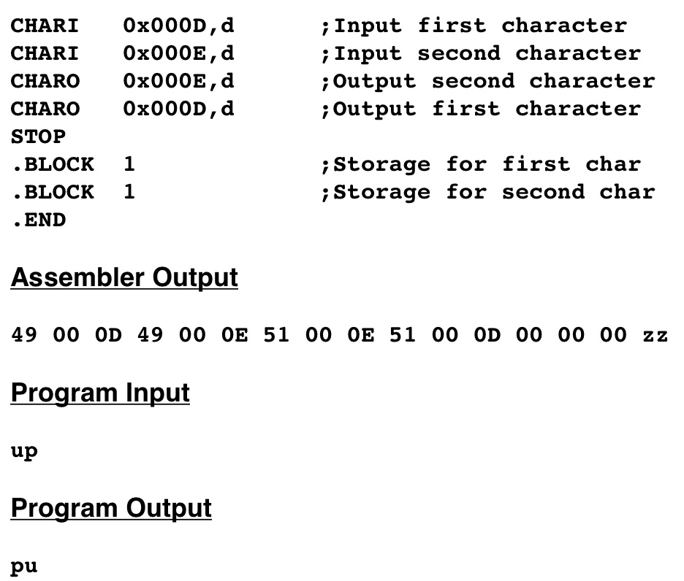
BLOCK…allocate bytes.
Any number not prefaced with
0x is interpreted as decimal
Could replace these 2
With a single
.BLOCK 2
Notes:
Note how each <click> .BLOCK reserves one byte of storage.
<click>
Also note that any numbers that are not preceded with 0x are interpreted as decimal numbers
<click>
These two .BLOCK statements could be replaced with a single .BLOCK 2

Slide 25
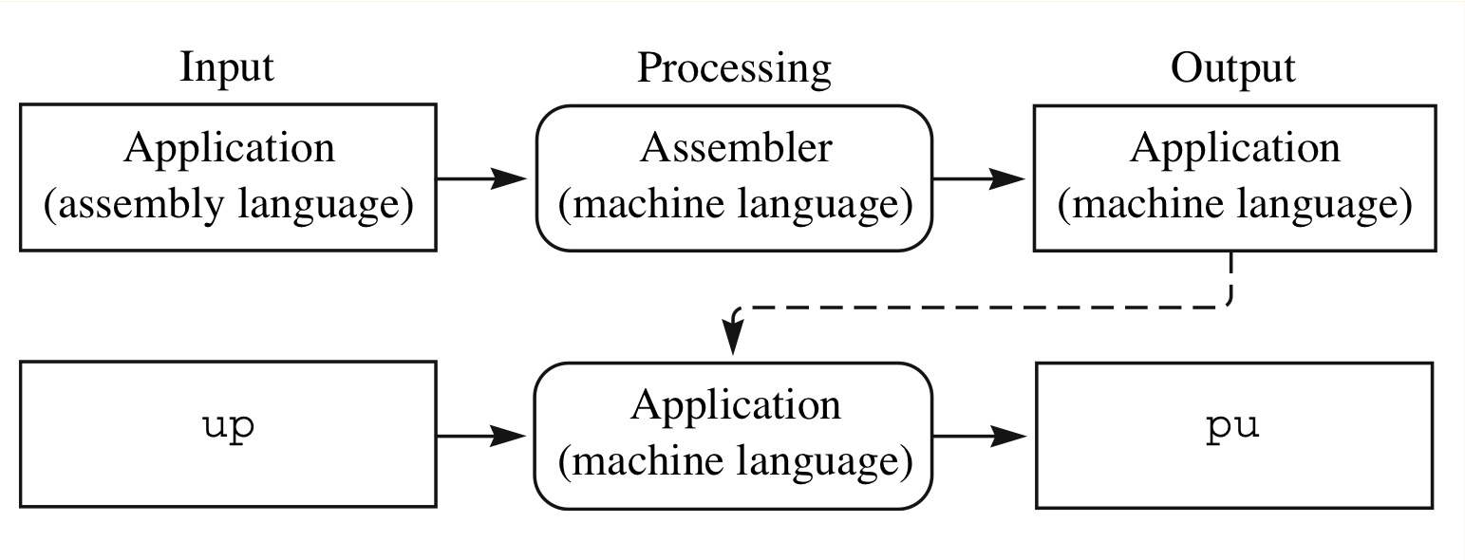
Two computer runs necessary for execution
Notes:
When Assembly language is used, it take two different computer processes to execute the program.
First the Assembler must process it into machine language, then the machine code must be loaded and ran.

Slide 26
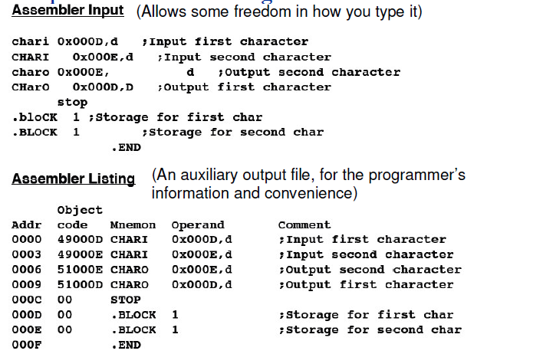
Assembler Listing for 5.8
After Pep/8 assembles a program, can show an assembler listing.
Contains Address, hex code, assembly
Notes:
The source code or Assembly language has some flexibility with respect to upper & lower case and spacing.
After the Assembler has processed it, an Assembler listing is produced with Addresses, Object code, assembly mneumonics, and comments in nice neat consistent columns.

Slide 27
Cross Assemblers
Different chips have different instructions sets
Assembler written in the same language as the language to which it translates
Called a resident assembler
Can also write an assembler to translate to a language for a different CPU
Called a cross assembler
Notes:
Remember machine code is machine specific and different CPUs have different instruction sets.
Typically, an application in assembly language is written and executed on the same computer.
The Assembler used in this case is written in the same language as the language to which it translates and is called a resident assembler.
However, it is also possible for a program to be written on one CPU and then be processed by an Assembler that outputs machine code for a different CPU. This is called a cross assembler. This is common when writing code for embedded processor systems. Small circuit boards with processers that will be dedicated to running an appliance or toy for example.

Slide 28
Cross Assemblers
Source
Code
Resident Assembler
Assembler
Intel P4
PowerPC G5
Notes:
In this diagram, it shows that the source code that is processed by a resident assembler on an Intel P4 computer produces machine code that can be run by the Intel P4 but not by the PowerPC G5.

Slide 29
Cross Assemblers
Source
Code
Cross Assembler
Assembler
Intel P4
PowerPC G5
Notes:
However, if the same code written on an Intel P4 is processed by a Cross Assembler for the PowerPC G5, the machine code produced can only be run on the PowerPC G5.

Slide 30
Cross Assemblers
Example: programming the controller in a microwave oven
Controller will have limited memory
Basic CPUs
So program and cross-assemble on a desktop computer
Transfer the code to the controller
Notes:
Embedded processor control boards have limited memory and a basic CPU to make them cheaper.
Here the example of your microwave oven is given.
It only needs to process the same functions over and over and the operating system and program are fixed.
So the program is developed on a desktop PC then cross-assembled into machine code for the CPU on the control board.
The code is transferred to the controller and ran there.

Slide 31
Immediate addressing
Learning Objectives:
Define immediate addressing mode
Describe instructions and operand formats for data: integers, characters, and strings
Use immediate addressing for data output and computation
Use symbolic labels for memory locations
Notes:
We have learned direct addressing in Chapter 4. Now let’s learn about Immediate addressing and how it can be used.

Slide 32
Direct addressing (from chapter 4)
Oprnd = Mem[OprndSpec]
Asmb5 letter: d
Operand specifier is the address in memory of the operand
Notes:
With direct addressing the Operand Specifier indicated the location or address in memory that the operand was stored.
In Assembly language it is specified with the letter d at the end of the instruction.

Slide 33
Immediate addressing
Oprnd = OprndSpec
Asmb5 letter: i
The operand specifier is the operand. Do not go to memory.
Notes:
With immediate addressing the operand specifier IS the operand.
In Assembly language it is specified with the letter i at the end of the instruction.

Slide 34
Direct addressing vs. Immediate addressing
Notes:
Here we see the difference between the instructions for both.
For direct addressing the RTL shows that the value at memory location 3 0 is obtained and added to the Accumulator , then stored in the accumulator.
For immediate addressing the RTL shows that the VALUE 3 0 is added to the Accumulator , then stored in the accumulator.

Slide 35
Direct addressing vs. Immediate addressing
Notes:
This shows that how the contents of the accumulator after these two different commands are executed.

Slide 36
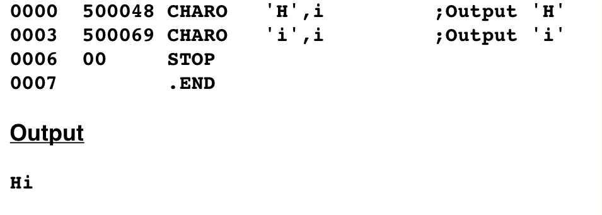
A program to output Hi using immediate addressing
character constant is enclosed in single quotes and generate 1 byte of code
Output
Hi
Machine bits: 0101 0000
Addressing mode: 000
Notes:
This example shows how the program to output Hi can be shortened by using immediate addressing.
The characters are contained in the instruction line and then output.

Slide 37
Character constants
This byte is sent to the output device
Character constant - enclosed in single quotes
Always allocates one byte
In operand specifier, 9 leading 0’s generated
8 for first byte, 1 for first bit of second byte (ASCII is 7 bits)
Character constant is in the rightmost byte of the word
When charo executes, it puts the rightmost byte onto the bus for the output device
charo 'H',i
0101 0000 0000 0000 0100 1000
Notes:
Remember that an operand specifier contains 16 bits or a word in the PEP8.
However, an ASCII character only uses 7 bits.
So when the operand specifier is determined by the assembler, the 7 bits are right justified and the leading 9 bits are filled with zeros.
When CHARO executes, only the right most byte is sent to the output device.

Slide 38
Immediate addressing
Advantages:
Program is shorter. 7 vs 9 bytes in this example
Instruction executes faster; don’t have to go to memory.
Notes:
Immediate addressing makes the program shorter and the instructions execute faster because they do not have to access memory.

Slide 39
Problems with Assembler so far…
Programmer must know where the data is in memory
Data goes at the bottom of memory, must write program before know where data goes
if you insert an instruction later all data addresses change
Single digit decimal input/output is tedious
CHARI/CHARO handle a single character, not numbers
Notes:
Here are some problems with our Assembly language solution at this point:
Programmer must know where the data is in memory.
Since the data goes at the bottom of memory, so we must write program before we know where data goes.
Then, if you insert an instruction later, all data addresses change.
Also, single digit decimal input/output is a pain! CHARI/CHARO handle a single character, not numbers.
This is long enough for this session, let’s ponder these problems and take a break.
We will resolve them in part 2 of the lecture on Assembly language.

